Slide 1
Allison Riley Grade Level: 5th Grade ESE Lesson Topic: Author’s Purpose

Slide 2
Through this PowerPoint presentation the students will learn the various reasons that the author writes:

Slide 3
What are some reasons that you write?
Video
This is a YouTube video that I will show to my students to introduce the topic.

Slide 4
Author’s Purpose

Slide 5
Authors can write:
To Persuade
To Entertain
To Express Feelings
To Inform

Slide 6
To Persuade:
• It’s the author’s goal to persuade the reader to agree with the author’s opinion.
• Even though the author shares his opinion, he may provide facts or examples to support the
opinion.
• Examples: advertisements, commercials, newspaper editorials, etc

Slide 7
To Persuade:
Example: Dogs are the best pets. They are very loving and helpful. You should get a dog.
Example #2:
It's New! It's Refreshing!
It's Slurpy Soda!
This is the best soda in the world! If you drink this soda you will jump higher, run faster and be smarter in school. Try one today!

Slide 8
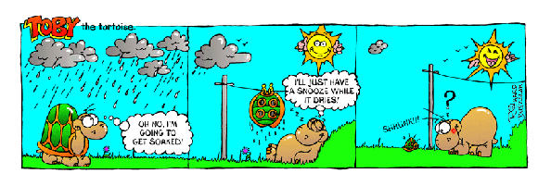
To Entertain:
It is the author’s goal to tell a story or describe real or imaginary characters, places, and events to entertain an audience.
Examples: stories, plays, comic strips, etc.

Slide 9
To Entertain:
Example:
Joe had been fishing for over two hours without a single bite. Suddenly there was a nibble at the end of his fishing line. He stood up on the boat and leaned out too far. Just then there was a sharp yank on the line. Joe fell overboard and landed head first into the water. Joe and his friends laughed and laughed.

Slide 10
To Express Feelings:
Any type of poetry is a way that authors express their feelings.
Example: Poetry

Slide 11
To Inform:
It’s the author’s goal to enlighten the reader with topics that are usually real or contain facts.
- Facts are used to teach, not to persuade.
- Examples: textbooks, cookbooks, newspapers

Slide 12
To Inform Example:
The giant panda is a bearlike animal that has thick white fur with black markings on its ears, limbs, shoulders, and around its eyes. The giant panda feeds on bamboo forests at high altitudes in western China. It also eats bulbs, roots, eggs, and some small mammals. The cubs are born in late winter. The giant panda is an endangered species and is protected by the Chinese government.

Slide 13
Practice Interactive Games for Students:
Activity #1
Activity #2
Activity #3

Slide 14
Check your knowledge…
1. When an author is trying to change the reader’s opinion they are trying _______________ the reader.
a. To Persuade
b. To Inform
c. To Express Feelings
d. To Entertain
2. When the author’s goal is to enlighten the reader with facts about a topic they are trying to _________________ the reader.
a. To Persuade
b. To Inform
c. To Express Feelings
d. To Entertain
3. When facts are used to teach, not to persuade.
a. To Persuade
b. To Inform
c. To Express Feelings
d. To Entertain
4. When an author uses any type of poetry the author is trying _____________ to the readers.
a. To Persuade
b. To Inform
c. To Express Feelings
d. To Entertain
5. When an author’s goal is to tell a story he or she is trying ______________ the readers.
a. To Persuade
b. To Inform
c. To Express Feelings
d. To Entertain

